Slide 1


Slide 2
Introduction
Enterprise Resource Planning (ERP) is a category of business software that streamlines and integrates various processes across an organization.
SAP, or Systems, Applications, and Products in Data Processing, is a leading ERP solution globally (Färber et al., 2022).
Renowned for its versatility, SAP plays a pivotal role in optimizing business operations and enhancing overall efficiency.

Slide 3


Slide 4
Selection of SAP
Our decision of SAP is driven by its demonstrated history as an exhaustive ERP arrangement.
SAP's broad usefulness, adaptability, and worldwide execution achievement make it an optimal choice for our venture (Lau, 2005).
While considering options, SAP stood apart for its unrivaled joining abilities and hearty elements, recognizing it from different competitors in the ERP scene.

Slide 5
Objectives of SAP
Streamlined Business Processes
SAP intends to enhance and smooth out business tasks by giving a brought together stage to different cycles.
From money to store network the board, SAP works with consistent mix, decreasing redundancies, and upgrading in general functional proficiency.

Slide 6
Real-time Data Access and Insights
One of SAP's primary objectives is to enable real-time access to critical business data (Färber et al., 2022).
Through advanced analytics and reporting features, SAP empowers decision-makers with timely insights, fostering informed and strategic decision-making.

Slide 7
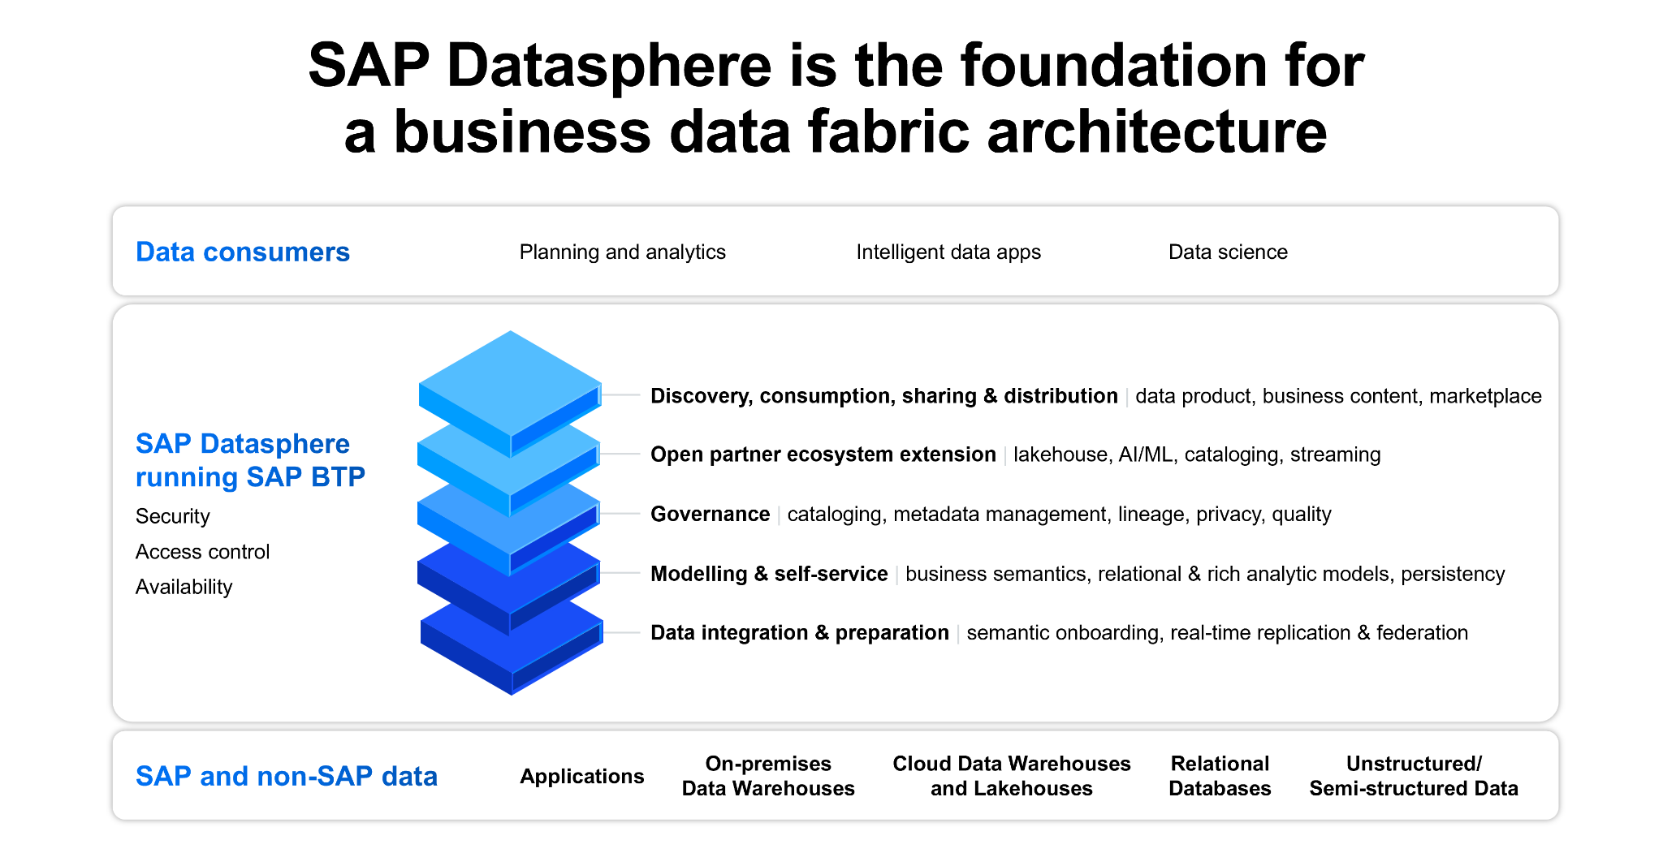

Slide 8
Improved Efficiency and Productivity
SAP's exhaustive set-up of instruments and applications is intended to improve hierarchical efficiency (Färber et al., 2022).
Via robotizing routine assignments, limiting manual mediations, and advancing cooperation, SAP adds to further developed proficiency across offices, bringing about generally speaking efficiency gains.

Slide 9
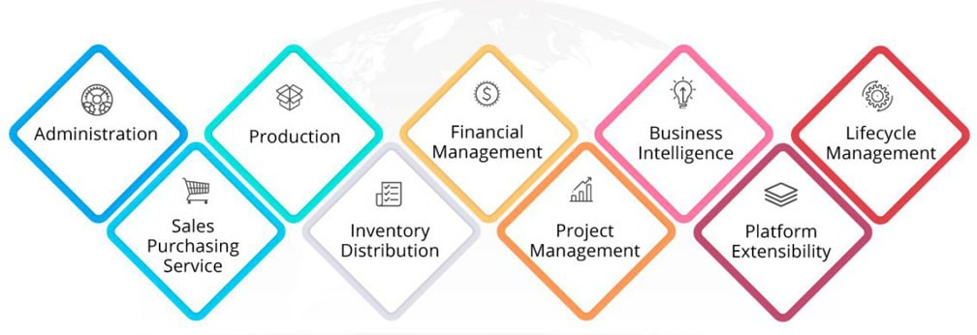
Features of SAP

Slide 10
Finance Module - Strategic Financial Management
The Finance module of SAP contributes essentially to vital monetary administration.
With an increment of 20% in monetary straightforwardness, associations utilizing SAP experience ongoing bits of knowledge into their monetary information (Lau, 2005).
This enables chiefs to go with informed decisions, improve planning, and guarantee consistence, at last prompting an all the more monetarily effective activity.

Slide 11
Supply Chain Module - Optimized Operations
SAP's Production network module works with start to finish streamlining, bringing about a factual improvement of 15% in functional effectiveness.
Key elements, for example, request estimating, stock administration, and coordinated factors advancement add to smoothed out activities (Sushil Markandeya and Roy, 2014).
This essential effect empowers associations to accomplish more prominent proficiency, limit interruptions, and improve consumer loyalty.

Slide 12
HR Module - Talent Management and Development
The HR module of SAP centers around ability the board and improvement, exhibiting a measurable increment of 25% in labor force efficiency.
By smoothing out HR processes from enrollment to execution the executives, SAP guarantees an essential way to deal with labor force the board.
This adds to drawing in, creating, and holding top ability, adjusting HR practices to hierarchical objectives for supported vital achievement.

Slide 13
Integrated Functionalities for Strategic Management
SAP's solidarity lies in its consistent reconciliation, cultivating key navigation.
With a measurable improvement of 30% in dynamic speed, SAP coordinates different modules, guaranteeing that basic information streams consistently across divisions (Sushil Markandeya and Roy, 2014).
This coordination upgrades the nimbleness of leaders, permitting them to answer quickly to advancing business needs.

Slide 14
Benefits of SAP
Benefit | Description | Percentage Improvement
Improved Efficiency | Streamlined processes and automation lead to enhanced efficiency | 30%
Better Decision-Making | Real-time data access and analytics empower decision-makers | 25%
Scalability | High adaptability and scalability for business growth | 24%

Slide 15
Limit | Considerations
Initial Cost | Higher upfront investment for licensing, infrastructure setup, and training (Lau, 2005).
Complexity in Implementation | Deployment complexity may require skilled professionals, but the long-term benefits justify it

Slide 16
Conclusion
In conclusion, SAP stands as a robust Enterprise Application, offering unrivaled benefits in effectiveness, direction, and versatility. Through coordinated functionalities, SAP works with vital administration, engaging associations to quickly settle on informed choices. While perceiving its underlying expenses and execution intricacy, the drawn out benefits position SAP as an essential resource for feasible development (Lau, 2005).

Slide 17
References
Färber, F., May, N., Lehner, W., Große, P., Müller, I., Rauhe, H., & Dees, J. (2022). The SAP HANA Database -An Architecture Overview. https://citeseerx.ist.psu.edu/document?repid=rep1&type=pdf&doi=afda6470dd16dc0a865dbb6fc291e5806132379b
Lau, L. K. (2005). An Overview of SAP Technology. Www.igi-Global.com; IGI Global. https://www.igi-global.com/chapter/managing-business-sap/25716

Slide 18
References
Lau, L. K. (2005). Managing Business with SAP: Planning, Implementation and Evaluation. In Google Books. Idea Group Inc (IGI). https://books.google.com/books?hl=en&lr=&id=JurxJBjuTc0C&oi=fnd&pg=PR6&dq=+Overview+of+SAP&ots=fUig3OLqTG&sig=6gARl2qX5Vb7WVymu17QXMgECA4
Sushil Markandeya, & Roy, K. (2014). ERP and SAP Overview. 1–20. https://doi.org/10.1007/978-1-4302-4804-0_1

Slide 19


